Slide 1
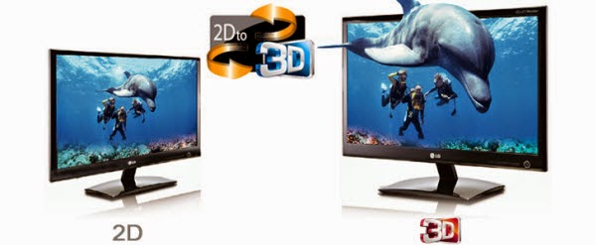
Build a Simple Algorithm to convert 2D image to 3D
Visual Memory is the strongest memory of all other types of memory. LET’S GIVE OUR VISION A VISION WHO IS THE DOMINANT
OF ALL SENSES
Prepared by
Debasis Mohanty
(UEBA19001)

Slide 2

Introduction
2D to 3D video conversion is the process of transforming 2D ("flat") film to 3D form, which in almost all cases is stereo, so it is the process of creating imagery for each eye from one 2D image
2D-to-3D conversion adds the binocular disparity depth cue to digital images perceived by the brain, thus, if done properly, greatly improving the immersive effect while viewing stereo video in comparison to 2D video.
in order to be successful, the conversion should be done with sufficient accuracy and correctness: the quality of the original 2D images should not deteriorate, and the introduced disparity cue should not contradict other cues used by the brain for depth perception.

Slide 3
Importance and Applicability
With the increase of films released in 3D, 2D to 3D conversion has become more common.
The majority of non-CGI stereo 3D blockbusters are converted fully or at least partially from 2D footage. Even Avatar contains several scenes shot in 2D and converted to stereo in post-production.
The reasons for shooting in 2D instead of stereo are financial, technical and sometimes artistic.
Stereo post-production workflow is much more complex and not as well-established as 2D workflow, requiring more work and rendering.

Slide 4
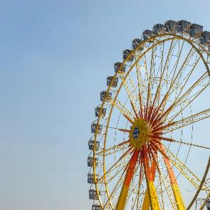

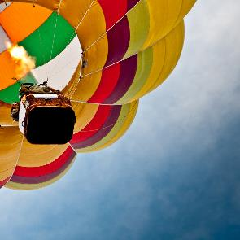



2D Images

Slide 5

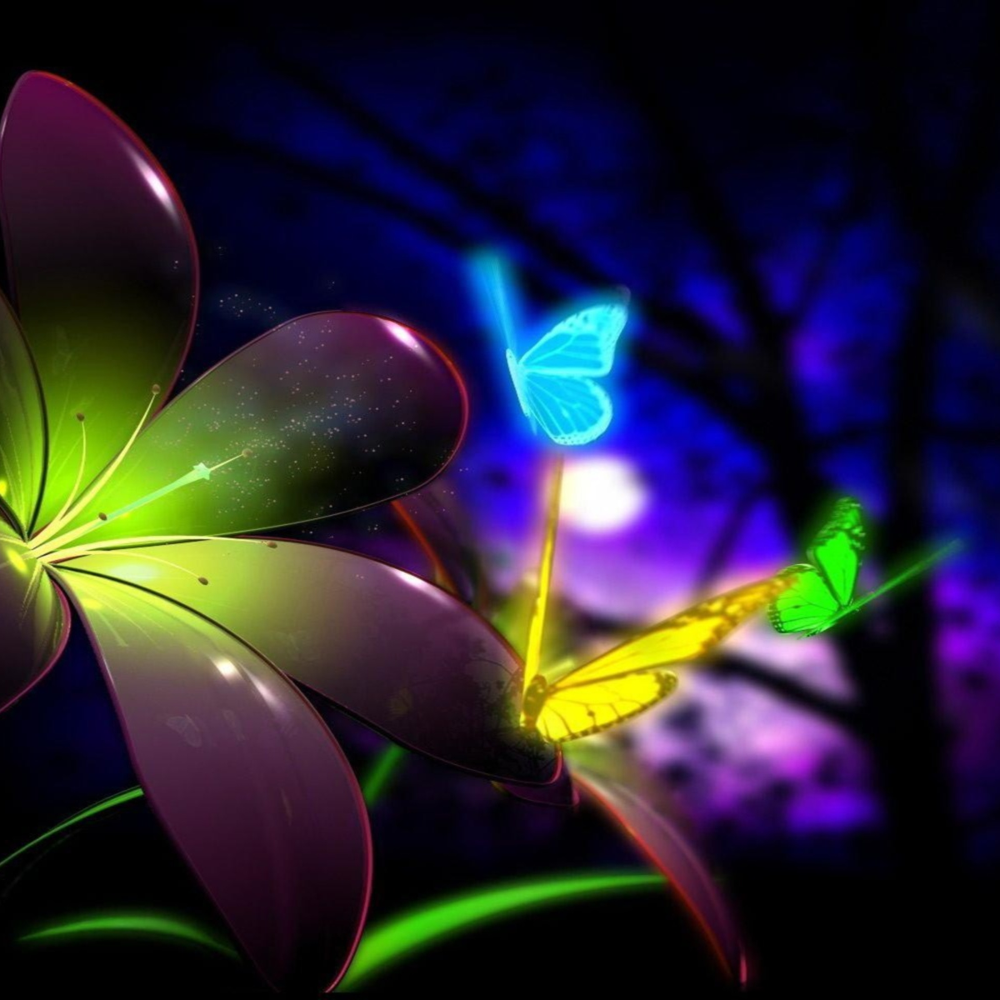

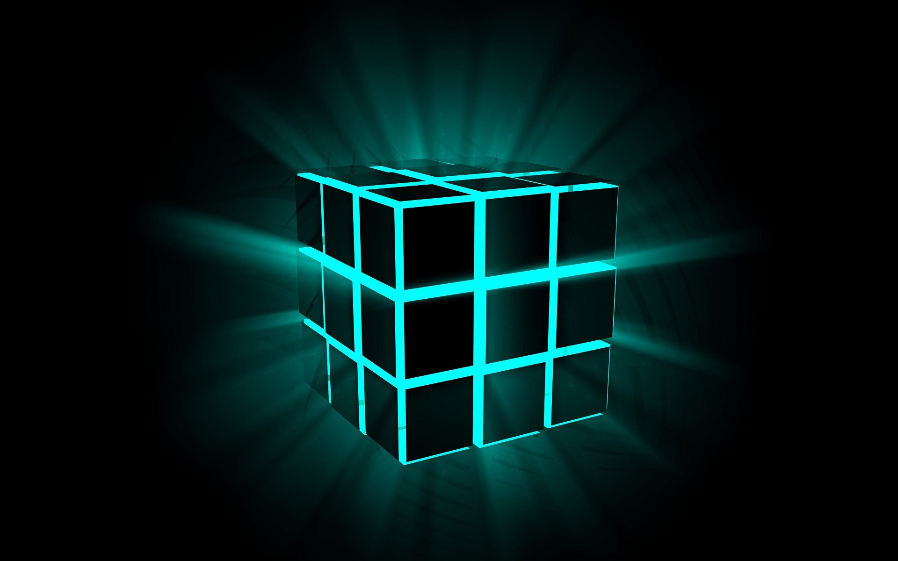
3D Images

Slide 6
Problems and Discrepancies
Allocation of "depth budget" – defining the range of permitted disparity or depth, what depth value corresponds to the screen position (so-called "convergence point" position), the permitted distance ranges for out-of-the-screen effects and behind-the-screen background objects.
Control of comfortable disparity depending on scene type and motion – too much parallax or conflicting depth cues may cause eye-strain and nausea effects
Filling of uncovered areas – left or right view images show a scene from a different angle, and parts of objects or entire objects covered by the foreground in the original 2D image should become visible in a stereo pair.

Slide 7
Bibliography
Softwares used are Blenders
Library used is ndimage library from scipy
https://github.com/apoorvjain25/Photo3D
Note : This project is still under process to achieve perfection.

Slide 8
Thank You

